Slide 1
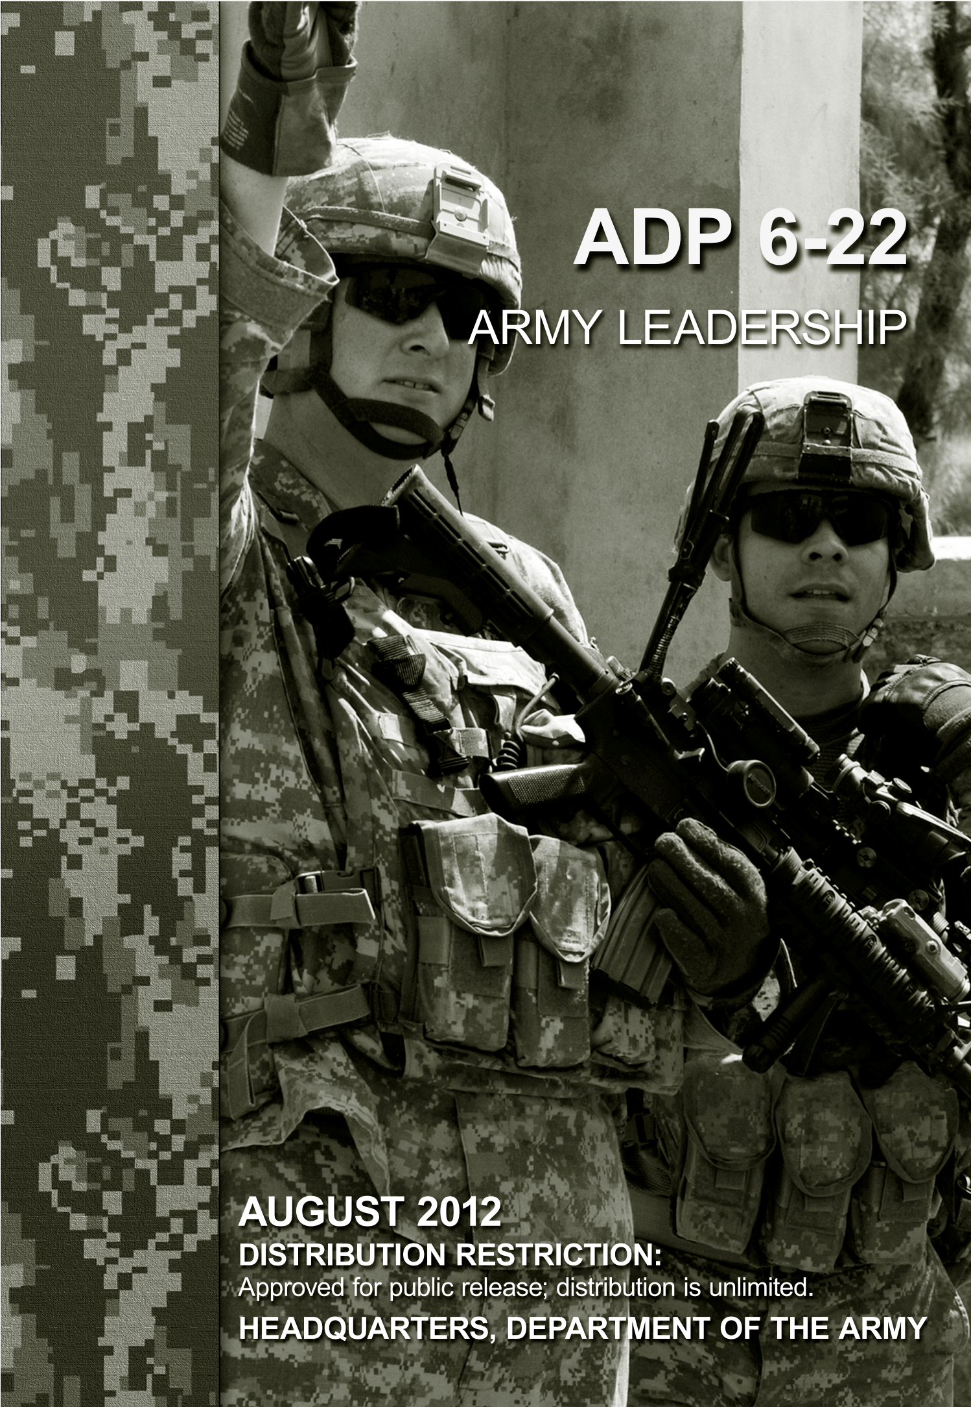
Exploring Documents as Data
Army Research Institute (ARI) Sponsored Project
DSPG Summer 2023

Slide 2
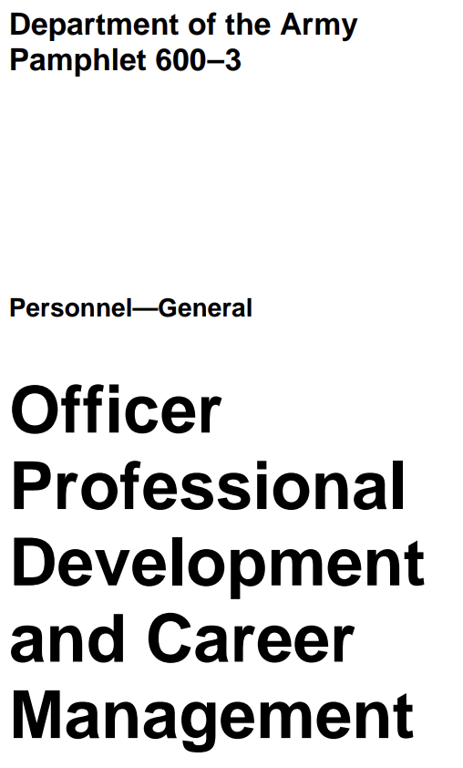


Project Description
Part 1. Exploring Methods to Extract Data From Documents
Goal 1: Build and analyze a dataset of key developmental positions and broadening assignments to inform models of Soldier career progression
Part 2. Exploring Approaches to Modeling Text Data
Goal 2: Compare the output of modeling strategies of performance-related Army administrative documents
e.g., where is there convergence/divergence in the identification of performance-related behaviors and their connections to psychosocial traits?
Goal 3: Contribute our knowledge of large language models to open-source repositories

Slide 3

You will learn...
Multiple methods to extract data from documents
e.g. manual extraction, optical character recognition (OCR)
Multiple methods to analyze text data
e.g. descriptive analysis, natural Descriptive and Natural language processing!)
Machine learning and large language models
e.g. Bidirectional Encoder Representations from Transformers (BERT), Generative pre-Trained Transformer (GPT-2)
Best practices in documentation and description of machine learning products and models
e.g. Contributing to dataset and model cards on Hugging Face, Explainable Artificial Intelligence

Slide 4






Team
Jo
Jo

